Slide 1
Data Preprocessing

Slide 2
Data Preprocessing
To make data more suitable for data mining.
To improve the data mining analysis with respect to time, cost and quality.

Slide 3
Why Data Preprocessing?
Data in the real world is dirty
  incomplete: lacking attribute values, lacking certain attributes of interest, or containing only aggregate data
  noisy: containing errors or outliers values that deviate from the expected
  inconsistent: containing discrepancies in codes or names
Data Mining: Concepts and Techniques

Slide 4
Why Is Data Dirty?
Incomplete data may come from
  “Not applicable” data value when collected
  Different considerations between the time when the data was collected and when it is analyzed.
  Human/hardware/software problems
Noisy data (incorrect values) may come from
  Faulty data collection instruments
  Human or computer error at data entry
  Errors in data transmission
Inconsistent data may come from
  Different data sources
  Functional dependency violation (e.g., modify some linked data)
Duplicate records also need data cleaning
Data Mining: Concepts and Techniques

Slide 5
Why Is Data Preprocessing Important?
No quality data, no quality mining results!
  Quality decisions must be based on quality data
    e.g., duplicate or missing data may cause incorrect or even misleading statistics.
  Data warehouse needs consistent integration of quality data
Data extraction, cleaning, and transformation comprises the majority of the work of building a data warehouse
Data Mining: Concepts and Techniques

Slide 6
Measures for data quality: A multidimensional view
  Accuracy: correct or wrong, accurate or not
  Completeness: not recorded, unavailable, …
  Consistency: some modified but some not, dangling, …
  Timeliness: timely update?
  Believability: how trustable the data are correct?
  Interpretability: how easily the data can be understood?

Slide 7
Data cleaning can be applied to remove noise and correct inconsistencies in the data.
Data cleaning routines work to “clean” the data by filling in missing values, smoothing noisy data, identifying or removing outliers, and resolving inconsistencies.
Data integration merges or integrates data from multiple sources such as databases, data cubes or files into a coherent data store, such as a data warehouse.
Steps must be taken to avoid redundancies during data integration
Data cleaning and Data integration are performed as a preprocessing step when preparing the data for a data warehouse.

Slide 8
Data transformations, such as normalization, may be applied. For example, normalization may improve the accuracy and efficiency of mining algorithms involving distance measurements.
Data reduction obtains a reduced representation of the data set that is much smaller in volume, yet produces the same (or almost the same) analytical results.
Data reduction can reduce the data size by aggregating, eliminating redundant features, or clustering, for instance.
These techniques are not mutually exclusive; they may work together.

Slide 9
There are a number of strategies for data reduction. These include
  data aggregation (e.g., building a data cube),
  attribute subset selection (e.g., removing irrelevant attributes through correlation analysis),
  dimensionality reduction (e.g., using encoding schemes such as minimum length encoding or wavelets), and
  numerosity reduction (e.g., “replacing” the data by alternative, smaller representations such as clusters or parametric models).

Slide 10
Descriptive data summarization serves as a foundation for data preprocessing.
Descriptive data summarization helps us study the general characteristics of the data and identify the presence of noise or outliers, which is useful for successful data cleaning and data integration.
Concept hierarchies can be used in an alternative form of data reduction where we replace low-level data (age) with higher-level concepts (youth or senior).

Slide 11
We should know basic concepts of descriptive data summarization before getting into the concrete workings of data preprocessing techniques.
For many data preprocessing tasks, users would like to learn about data characteristics regarding both central tendency and dispersion of the data.

Slide 12
Measures of central tendency (numerical measure of the “center” of a set of data) include mean, median, mode, and midrange, while Measures of data dispersion(degree to which numerical data tend to spread) include variance, range, quartiles, interquartile range (IQR), and standard deviation.

Slide 13
Notions of Measuring
Distributive measure - it is a measure (i.e., function) that can be computed for a given data set by partitioning the data into smaller subsets, computing the measure for each subset, and then merging the results in order to arrive at the measure’s value for the original (entire) data set. Eg: sum()
Algebraic measure – it is a measure that can be computed by applying an algebraic function to one or more distributive measures. Eg: average ()
Holistic measure - is a measure that must be computed on the entire data set as a whole. Eg: median()

Slide 14
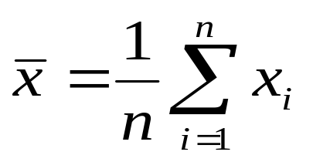
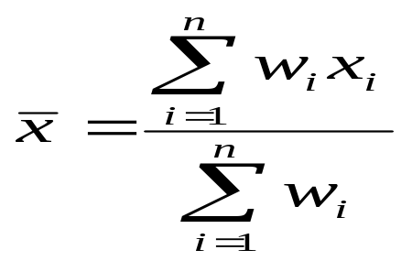

Measuring the Central Tendency
Mean (algebraic measure) (sample vs. population):
  Weighted arithmetic mean:
  Trimmed mean: chopping extreme values
Median: A holistic measure
  Middle value if odd number of values, or average of the middle two values otherwise
  Estimated by interpolation (for grouped data):
Mode
  Value that occurs most frequently in the data
  Unimodal, bimodal, trimodal
  multimodal
  Empirical formula:

Slide 15



Symmetric vs. Skewed Data
Median, mean and mode of symmetric, positively and negatively skewed data
Data Mining: Concepts and Techniques

Slide 16
Measuring the Dispersion of Data
The range of the set is the difference between the largest (max()) and smallest (min()) values.
The k^{th} percentile of a set of data in numerical order is the value x_{i} having the property that k percent of the data entries lie at or below x_{i}.
The median is the 50th percentile. The first quartile, denoted by Q1, is the 25th percentile; the third quartile, denoted by Q3, is the 75th percentile.

Slide 17
The distance between the first and third quartiles is a simple measure of spread that gives the range covered by the middle half of the data. This distance is called the interquartile range (IQR) and is defined as
IQR = Q3-Q1.

Slide 18
A common rule of thumb for identifying suspected outliers is to single out values falling at least 1:5xIQR above the third quartile or below the first quartile.
Q1, the median, and Q3 together contain no information about the endpoints (e.g., tails) of the data.
a fuller summary of the shape of a distribution can be obtained by providing the lowest and highest data values as well. This is known as the five-number summary.
The five-number summary of a distribution consists of the median, the quartiles Q1 and Q3, and the smallest and largest individual observations, written in the order
Minimum; Q1; Median; Q3; Maximum

Slide 19
Boxplots are a popular way of visualizing a distribution.
A boxplot incorporates the five-number summary as follows:
  the ends of the box are at the quartiles, so that the box length is the interquartile range, IQR.
  The median is marked by a line within the box.
  Two lines (called whiskers) outside the box extend to the smallest (Minimum) and largest (Maximum) observations.

Slide 20
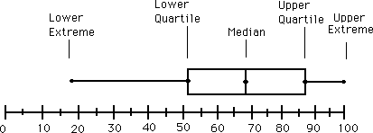
Data is represented with a box- Boxplot

Slide 21
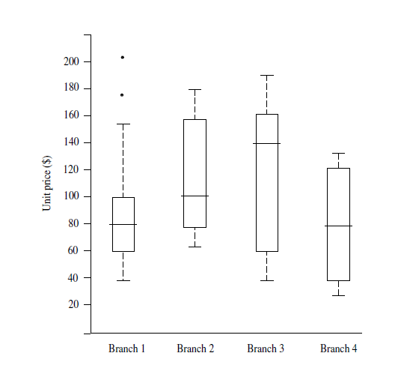

Slide 22

The variance of N observations, x₁,x₂,……x_{N}, is
Where x is the mean value of the observations
  Standard deviation s (or σ) is the square root of variance s² ⁽or σ²⁾

Slide 23
Graphic Displays of Basic Descriptive Data Summaries
Histograms
Quantile plots
Q-Q plots
Scatter plots
Loess curves
Bar charts
Pie charts
Line graphs

Slide 24
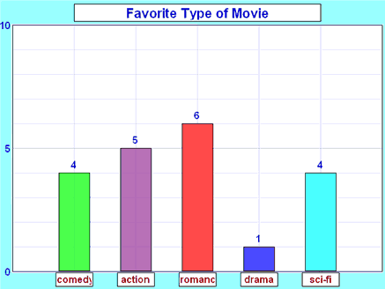
Bar Graph

Slide 25
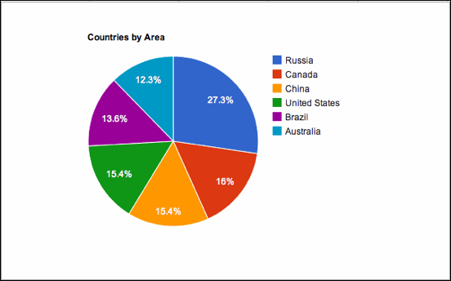
Pie chart

Slide 26
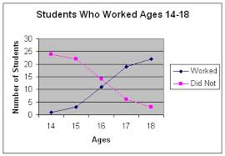
Line Graph

Slide 27
Histograms
Plotting histograms, or frequency histograms, is a graphical method for summarizing the distribution of a given attribute.
A histogram for an attribute A partitions the data distribution of A into disjoint subsets, or buckets.
width of each bucket is uniform.
Each bucket is represented by a rectangle whose height is equal to the count or relative frequency of the values at the bucket.

Slide 28
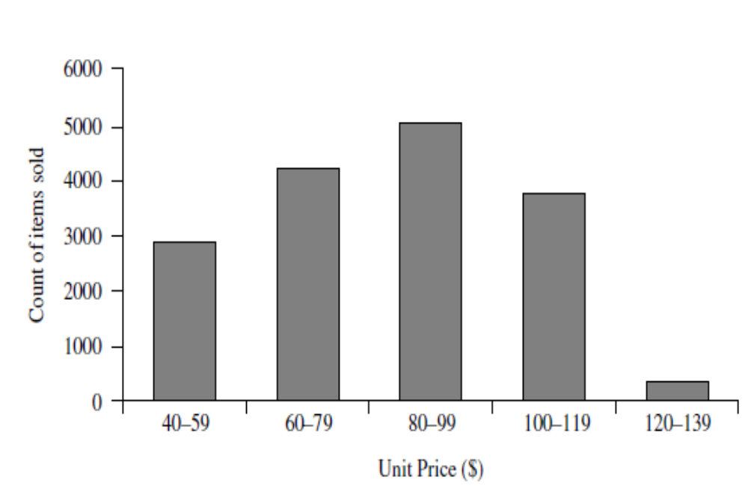

Slide 29
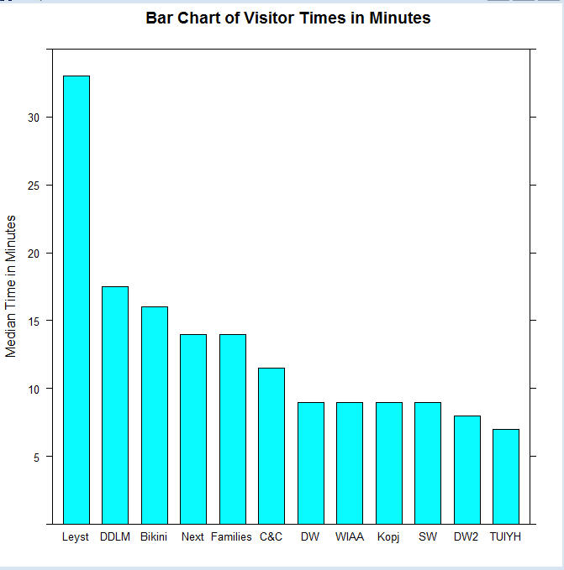
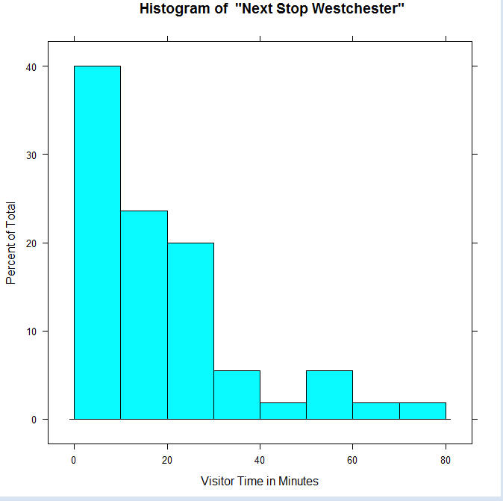

Slide 30
Quantile plot
A quantile plot is a simple and effective way to have a univariate data distribution.
First, it displays all of the data for the given attribute (allowing the user to assess both the overall behavior and unusual occurrences).
Second, it plots quantile information. (each of any set of values of a variate which divide a frequency distribution into equal groups, each containing the same fraction of the total population. )

Slide 31
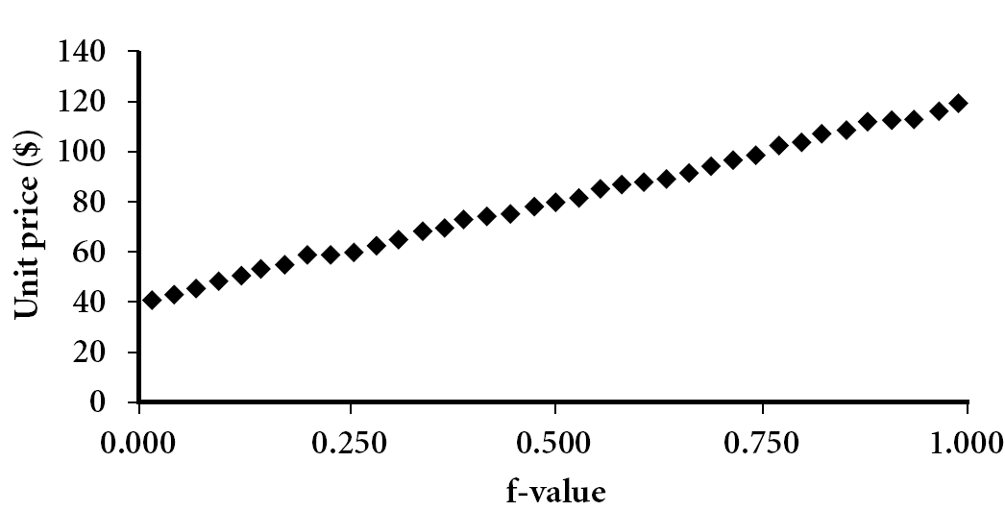

Slide 32
Quantile-Quantile (Q-Q) Plot
Graphs the quantiles of one univariate distribution against the corresponding quantiles of another
Allows the user to view whether there is a shift in going from one distribution to another

Slide 33
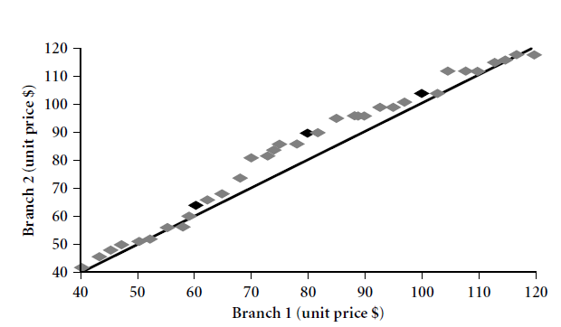

Slide 34
Scatter plot
A scatter plot is one of the most effective graphical methods for determining if there appears to be a relationship, pattern, or trend between two numerical attributes.
To construct a scatter plot, each pair of values is treated as a pair of coordinates in an algebraic sense and plotted as points in the plane.

Slide 35
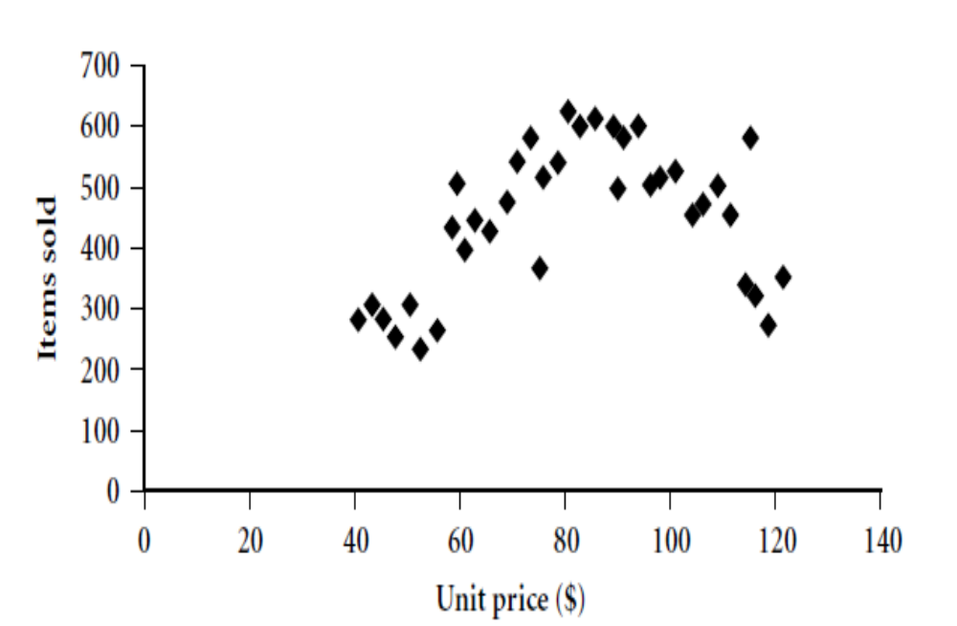

Slide 36
Loess curve
A loess curve is another important exploratory graphic aid that adds a smooth curve to a scatter plot in order to provide better perception of the pattern of dependence.
The word loess is short for “local regression.”

Slide 37
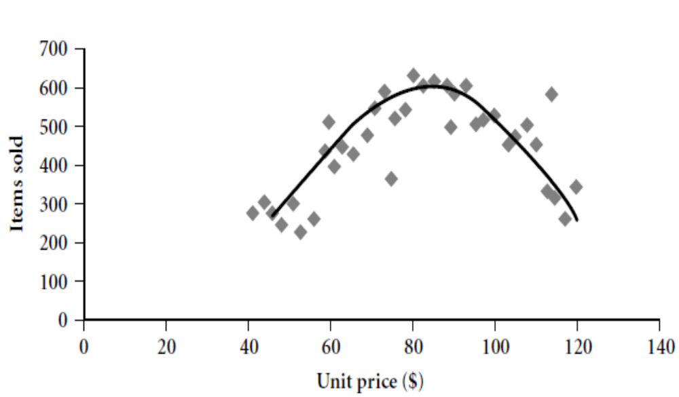

Slide 38
Types of Data Sets
Record
  Relational records
  Data matrix, e.g., numerical matrix, crosstabs
  Document data: text documents: term-frequency vector
  Transaction data
Graph and network
  World Wide Web
  Social or information networks
  Molecular Structures
Ordered
  Video data: sequence of images
  Temporal data: time-series
  Sequential Data: transaction sequences
  Genetic sequence data
Spatial, image and multimedia:
  Spatial data: maps
  Image data:
  Video data:
Notes:
May we categorize data along the following dimensions?
- structured, semi-structured, and unstructured
- numeric and categorical
- static and dynamic (temporal?)
- by application

Slide 39
Data Objects
Data sets are made up of data objects.
A data object represents an entity.
Data objects are described by attributes.
Database rows -> data objects; columns ->attributes.
Attribute (or dimensions, features, variables): a data field, representing a characteristic or feature of a data object.

Slide 40
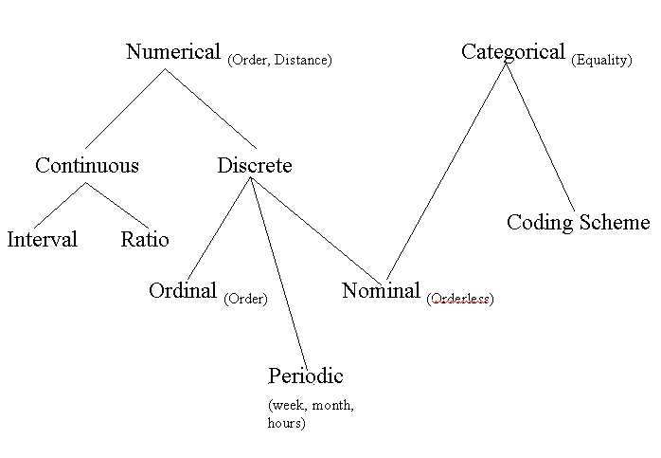
Attribute Types
Binary

Slide 41
Continuous Attribute
  Has real numbers as attribute values
    E.g., temperature, height, or weight
Discrete Attribute
  Has only a finite or countably infinite set of values
    E.g., zip codes, profession, or the set of words in a collection of documents

Slide 42
Interval
    Measured on a scale of equal-sized units
    Values have order
      E.g., temperature in C˚or F˚, calendar dates
Ratio
    We can speak of values as being an order of magnitude larger than the unit of measurement (10 K˚ is twice as high as 5 K˚).
      e.g., temperature in Kelvin, length, counts, monetary quantities

Slide 43
Nominal: categories, states, or “names of things”
  Hair_color = {auburn, black, blond, brown, grey, red, white}
  marital status, occupation, ID numbers, zip codes
Binary
  Nominal attribute with only 2 states (0 and 1)
  Symmetric binary: both outcomes equally important
    e.g., gender
  Asymmetric binary: outcomes not equally important.
    e.g., medical test (positive vs. negative)
    Convention: assign 1 to most important outcome (e.g., HIV positive)
Ordinal
  Values have a meaningful order (ranking) but magnitude between successive values is not known.
  Size = {small, medium, large}, grades, army rankings

Slide 44
Major Tasks in Data Preprocessing
Data cleaning
  Fill in missing values, smooth noisy data, identify or remove outliers, and resolve inconsistencies
Data integration
  Integration of multiple databases, data cubes, or files
Data transformation
  Normalization and aggregation
Data reduction
  Obtains reduced representation in volume but produces the same or similar analytical results
Data discretization
  Part of data reduction but with particular importance, especially for numerical data

Slide 45
Data Cleaning
Importance
  “Data cleaning is one of the three biggest problems in data warehousing”—Ralph Kimball
  “Data cleaning is the number one problem in data warehousing”—DCI survey

Slide 46
Data cleaning tasks
  Fill in missing values
  Identify outliers and smooth out noisy data
  Correct inconsistent data
  Resolve redundancy caused by data integration

Slide 47
Missing Data
Data is not always available
  E.g., many tuples have no recorded value for several attributes, such as customer income in sales data
Missing data may be due to
  equipment malfunction
  inconsistent with other recorded data and thus deleted
  data not entered due to misunderstanding
  certain data may not be considered important at the time of entry
  not register history or changes of the data
Missing data may need to be inferred.

Slide 48
How to Handle Missing Data?
Ignore the tuple: usually done when class label is missing (assuming the tasks in classification—not effective when the percentage of missing values per attribute varies considerably.
Fill in the missing value manually: tedious + infeasible?
Fill in it automatically with
  a global constant : e.g., “unknown”, a new class?!
  the attribute mean
  the attribute mean for all samples belonging to the same class: smarter
  the most probable value: inference-based such as Bayesian formula or decision tree or EM algorithm.

Slide 49
How to Handle Missing Data?
Age | Income | Team | Gender
23 | 24,200 | Red Sox | M
39 | ? | Yankees | F
45 | 45,390 | ? | F
Fill missing values using aggregate functions (e.g., average) or probabilistic estimates on global value distribution
E.g., put the average income here, or put the most probable income based on the fact that the person is 39 years old
E.g., put the most frequent team here

Slide 50
Noisy Data
Noise: random error or variance in a measured variable
Incorrect attribute values may due to
  faulty data collection instruments
  data entry problems
  data transmission problems
  technology limitation
  inconsistency in naming convention
Other data problems which requires data cleaning
  duplicate records
  incomplete data
  inconsistent data

Slide 51
How to Handle Noisy Data?
Binning method:
  first sort data and partition into (equi-depth) bins
  then one can smooth by bin means, smooth by bin median, smooth by bin boundaries, etc.
Clustering
  Similar values are organized into groups (clusters).
  Values that fall outside of clusters considered outliers.
Regression
  Data can be smoothed by fitting the data to a function such as with regression.
Combined computer and human inspection
  detect suspicious values and check by human (e.g., deal with possible outliers)

Slide 52
Binning
Binning methods smooth a sorted data value by consulting its “neighborhood,” that is, the values around it. The sorted values are distributed into a number of “buckets,” or bins.
  first sort data and partition into (equal-frequency) bins
  then one can smooth by bin means (each value in a bin is replaced by the mean value of the bin), smooth by bin median (each bin value is replaced by the bin median), smooth by bin boundaries (the minimum and maximum values in a given bin are identified as the bin boundaries. Each bin value is then replaced by the closest boundary value), etc.

Slide 53
Binning methods for data smoothing
Sorted data for price (in dollars): 4, 8, 15, 21, 21, 24, 25, 28, 34
Partition into (equal-frequency) bins:
  Bin 1: 4, 8, 15
  Bin 2: 21, 21, 24
  Bin 3: 25, 28, 34
Smoothing by bin means:
  Bin 1: 9, 9, 9
  Bin 2: 22, 22, 22
  Bin 3: 29, 29, 29
Smoothing by bin boundaries:
  Bin 1: 4, 4, 15
  Bin 2: 21, 21, 24
  Bin 3: 25, 25, 34

Slide 54
Simple Discretization Methods: Binning
Equal-width (distance) partitioning
  Divides the range into N intervals of equal size: uniform grid
  if A and B are the lowest and highest values of the attribute, the width of intervals will be: W = (B –A)/N.
  The most straightforward, but outliers may dominate presentation
  Skewed data is not handled well
Equal-depth (frequency) partitioning
  Divides the range into N intervals, each containing approximately same number of samples
  Good data scaling
  Managing categorical attributes can be tricky

Slide 55
Regression
  smooth by fitting the data into regression functions
  Two types - linear regression and multiple linear regression
  Linear regression involves finding the “best” line to fit two attributes (or variables), so that one attribute can be used to predict the other.
  Multiple linear regression is an extension of linear regression, where more than two attributes are involved and the data are fit to a multidimensional surface.

Slide 56
Regression
y
Y1
Y1’
y = x + 1
X1
x

Slide 57
Clustering
  where similar values are organized into groups, or “clusters.”
  values that fall outside of the set of clusters may be considered outliers

Slide 58
Cluster Analysis

Slide 59
Combined computer and human inspection
  detect suspicious values and check by human
  e.g., deal with possible outliers

Slide 60
Data Cleaning as a Process
Data discrepancy detection
(Discrepancies can be caused by several factors, including poorly designed data entry forms that have many optional fields, human error in data entry, deliberate errors (e.g., respondents not wanting to divulge information about themselves), and data decay (e.g., outdated addresses).)
  Use metadata(“data about data”) (e.g., domain, range, dependency, distribution)
  Check field overloading
  Check uniqueness rule, consecutive rule and null rule
  Use commercial tools
    Data scrubbing: use simple domain knowledge (e.g., postal code, spell-check) to detect errors and make corrections
    Data auditing: by analyzing data to discover rules and relationship to detect violators (e.g., correlation and clustering to find outliers)

Slide 61
Data migration and integration
  Data migration tools: allow transformations to be specified
  ETL (Extraction/Transformation/Loading) tools: allow users to specify transformations through a graphical user interface
Integration of the two processes
  Iterative and interactive (e.g., Potter’s Wheels)

Slide 62
Data Integration
Data integration:
  Combines data from multiple sources into a coherent store
Schema integration: e.g., A.cust-id ≡ B.cust-#
  Integrate metadata from different sources
Entity identification problem:
  Identify real world entities from multiple data sources,
  e.g. 1 :- Bill Clinton = William Clinton
  e.g. 2 :- customer id = customer number
Notes:
Should ask students to do some survey on data integration. -JH

Slide 63
Detecting and resolving data value conflicts
  For the same real world entity, attribute values from different sources are different
  Possible reasons: different representations, different scales, e.g., metric vs. British units

Slide 64
Handling Redundancy in Data Integration
Redundant data occur often when integration of multiple databases
  Object identification: The same attribute or object may have different names in different databases
  Derivable data: One attribute may be a “derived” attribute in another table, e.g., annual revenue
Redundant attributes may be able to be detected by correlation analysis and covariance analysis
Careful integration of the data from multiple sources may help reduce/avoid redundancies and inconsistencies and improve mining speed and quality

Slide 65
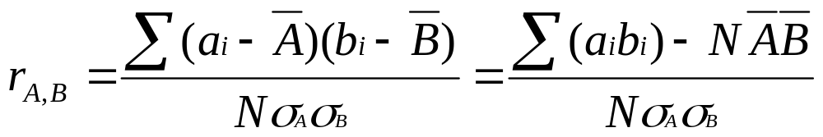


Correlation Analysis (Numerical Data)
Correlation coefficient (also called Pearson’s product moment coefficient)
where N is the number of tuples, a_{i} and b_{i} are the respective values of A and B in tuple i, and are the respective means of A and B, σ_{A} and σ_{B} are the respective standard deviation of A and B, and Σ(a_{i}b_{i}) is the sum of the AB cross-product ie for each tuple, the value for A is multiplied by the value for B in that tuple.
If r_{A,B} > 0, A and B are positively correlated (A’s values increase as B’s). The higher, the stronger correlation.
r_{A,B} = 0: independent; r_{A,B} < 0: negatively correlated
Data Mining: Concepts and Techniques

Slide 66

Correlation Analysis (Nominal Data)
Χ² (chi-square) test
The larger the Χ² value, the more likely the variables are related
The cells that contribute the most to the Χ² value are those whose actual count is very different from the expected count
Expected = count(a_{i}) x count (b_{j})
N

Slide 67
Chi-Square Calculation: An Example
 | Play chess | Not play chess | Sum (row)
Like science fiction | 250(90) | 200(360) | 450
Not like science fiction | 50(210) | 1000(840) | 1050
Sum(col.) | 300 | 1200 | 1500
Χ² (chi-square) calculation (numbers in parenthesis are expected counts calculated based on the data distribution in the two categories)
It shows that like_science_fiction and play_chess are correlated in the group
Contingency table

Slide 68
Data Transformation
Smoothing: remove noise from data
Aggregation: summarization, data cube construction
Generalization: concept hierarchy climbing
Normalization: scaled to fall within a small, specified range
  min-max normalization
  z-score normalization
  normalization by decimal scaling
Attribute/feature construction
  New attributes constructed from the given ones

Slide 69





Data Transformation: Normalization
Min-max normalization: to [new_min_{A}, new_max_{A}]
  Ex. Let income range $12,000 to $98,000 normalized to [0.0, 1.0]. Then $73,000 is mapped to
Z-score normalization (μ: mean, σ: standard deviation):
  Ex. Let μ = 54,000, σ = 16,000. Then
Normalization by decimal scaling
Where j is the smallest integer such that Max(|ν’|) < 1

Slide 70
Data Reduction Strategies
Why data reduction?
  A database/data warehouse may store terabytes of data
  Complex data analysis/mining may take a very long time to run on the complete data set
Data reduction
  Obtain a reduced representation of the data set that is much smaller in volume but yet produce the same (or almost the same) analytical results
Data reduction strategies
  Data cube aggregation:
  Dimensionality reduction — e.g., remove unimportant attributes
  Data Compression
  Numerosity reduction — e.g., fit data into models
  Discretization and concept hierarchy generation

Slide 71
Data Cube Aggregation
The lowest level of a data cube (base cuboid)
  The aggregated data for an individual entity of interest
  E.g., a customer in a phone calling data warehouse
Multiple levels of aggregation in data cubes
  Further reduce the size of data to deal with
Reference appropriate levels
  Use the smallest representation which is enough to solve the task
Queries regarding aggregated information should be answered using data cube, when possible

Slide 72
Attribute Subset Selection
Feature selection (i.e., attribute subset selection):
  Select a minimum set of features such that the probability distribution of different classes given the values for those features is as close as possible to the original distribution given the values of all features
  reduce # of patterns in the patterns, easier to understand
Heuristic methods (due to exponential # of choices):
  Step-wise forward selection
  Step-wise backward elimination
  Combining forward selection and backward elimination
  Decision-tree induction

Slide 73
Example of Decision Tree Induction
Initial attribute set:
{A1, A2, A3, A4, A5, A6}
A4 ?
A1?
A6?
Class 1
Class 2
Class 1
Class 2
>
Reduced attribute set: {A1, A4, A6}

Slide 74
Heuristic Feature Selection Methods
There are 2^{d} possible sub-features of d features
Several heuristic feature selection methods:
  Best single features under the feature independence assumption: choose by significance tests
  Best step-wise feature selection:
    The best single-feature is picked first
    Then next best feature condition to the first, ...
  Step-wise feature elimination:
    Repeatedly eliminate the worst feature
  Best combined feature selection and elimination
  Optimal branch and bound:
    Use feature elimination and backtracking

Slide 75
Data Compression
String compression
  There are extensive theories and well-tuned algorithms
  Typically lossless
  But only limited manipulation is possible without expansion
Audio/video compression
  Typically lossy compression, with progressive refinement
  Sometimes small fragments of signal can be reconstructed without reconstructing the whole
Time sequence is not audio
  Typically short and vary slowly with time

Slide 76
Data Compression
Original Data
Compressed
Data
lossless
Original Data
Approximated
lossy

Slide 77
Dimensionality Reduction:
Wavelet Transformation
Haar2
Daubechie4
Discrete wavelet transform (DWT): linear signal processing, multi-resolutional analysis
Compressed approximation: store only a small fraction of the strongest of the wavelet coefficients
Similar to discrete Fourier transform (DFT), but better lossy compression, localized in space
Method:
  Length, L, must be an integer power of 2 (padding with 0’s, when necessary)
  Each transform has 2 functions: smoothing, difference
  Applies to pairs of data, resulting in two set of data of length L/2
  Applies two functions recursively, until reaches the desired length

Slide 78
Dimensionality Reduction: Principal Component Analysis (PCA)
Given N data vectors from n-dimensions, find k ≤ n orthogonal vectors (principal components) that can be best used to represent data
Steps
  Normalize input data: Each attribute falls within the same range
  Compute k orthonormal (unit) vectors, i.e., principal components
  Each input data (vector) is a linear combination of the k principal component vectors
  The principal components are sorted in order of decreasing “significance” or strength
  Since the components are sorted, the size of the data can be reduced by eliminating the weak components, i.e., those with low variance. (i.e., using the strongest principal components, it is possible to reconstruct a good approximation of the original data
Works for numeric data only
Used when the number of dimensions is large

Slide 79
Principal Component Analysis
X2
Y1
Y2
X1

Slide 80
Numerosity Reduction
Reduce data volume by choosing alternative, smaller forms of data representation
Parametric methods
  Assume the data fits some model, estimate model parameters, store only the parameters, and discard the data (except possible outliers)
  Example: Log-linear models—obtain value at a point in m-D space as the product on appropriate marginal subspaces
Non-parametric methods
  Do not assume models
  Major families: histograms, clustering, sampling

Slide 81
Data Reduction Method (1): Regression and Log-Linear Models
Linear regression: Data are modeled to fit a straight line
  Often uses the least-square method to fit the line
Multiple regression: allows a response variable Y to be modeled as a linear function of multidimensional feature vector
Log-linear model: approximates discrete multidimensional probability distributions

Slide 82
Regress Analysis and Log-Linear Models
Linear regression: Y = w X + b
  Two regression coefficients, w and b, specify the line and are to be estimated by using the data at hand
  Using the least squares criterion to the known values of Y1, Y2, …, X1, X2, ….
Multiple regression: Y = b0 + b1 X1 + b2 X2.
  Many nonlinear functions can be transformed into the above
Log-linear models:
  The multi-way table of joint probabilities is approximated by a product of lower-order tables
  Probability: p(a, b, c, d) = αab βacχad δbcd

Slide 83
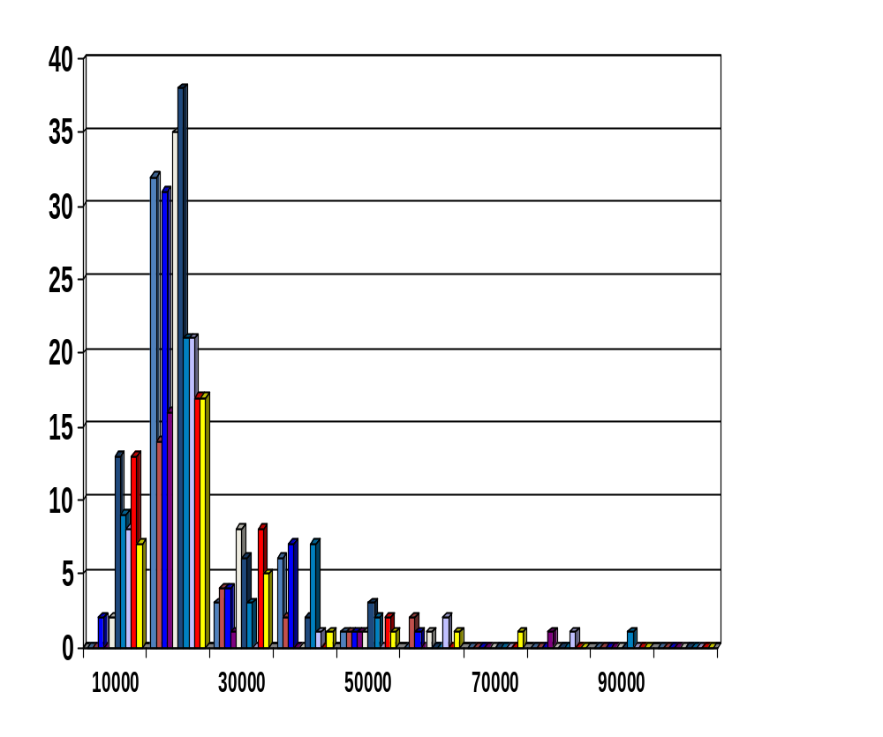
Data Reduction Method (2): Histograms
Divide data into buckets and store average (sum) for each bucket
Partitioning rules:
  Equal-width: equal bucket range
  Equal-frequency (or equal-depth)
  V-optimal: with the least histogram variance (weighted sum of the original values that each bucket represents)
  MaxDiff: set bucket boundary between each pair for pairs have the β–1 largest differences

Slide 84
Data Reduction Method (3): Clustering
Partition data set into clusters based on similarity, and store cluster representation (e.g., centroid and diameter) only
Can be very effective if data is clustered but not if data is “smeared”
Can have hierarchical clustering and be stored in multi-dimensional index tree structures
There are many choices of clustering definitions and clustering algorithms
Cluster analysis will be studied in depth in Chapter 7

Slide 85
Data Reduction Method (4): Sampling
Sampling: obtaining a small sample s to represent the whole data set N
Allow a mining algorithm to run in complexity that is potentially sub-linear to the size of the data
Choose a representative subset of the data
  Simple random sampling may have very poor performance in the presence of skew
Develop adaptive sampling methods
  Stratified sampling:
    Approximate the percentage of each class (or subpopulation of interest) in the overall database
    Used in conjunction with skewed data
Note: Sampling may not reduce database I/Os (page at a time)

Slide 86
Sampling: with or without Replacement
SRSWOR
(simple random
sample without
replacement)
SRSWR
Raw Data

Slide 87
Sampling: Cluster or Stratified Sampling
Raw Data
Cluster/Stratified Sample

Slide 88
Discretization
Three types of attributes:
  Nominal — values from an unordered set, e.g., color, profession
  Ordinal — values from an ordered set, e.g., military or academic rank
  Continuous — real numbers, e.g., integer or real numbers
Discretization:
  Divide the range of a continuous attribute into intervals
  Some classification algorithms only accept categorical attributes.
  Reduce data size by discretization
  Prepare for further analysis

Slide 89
Discretization and Concept Hierarchy
Discretization
  Reduce the number of values for a given continuous attribute by dividing the range of the attribute into intervals
  Interval labels can then be used to replace actual data values
  Supervised vs. unsupervised
  Split (top-down) vs. merge (bottom-up)
  Discretization can be performed recursively on an attribute
Concept hierarchy formation
  Recursively reduce the data by collecting and replacing low level concepts (such as numeric values for age) by higher level concepts (such as young, middle-aged, or senior)

Slide 90
Discretization and Concept Hierarchy Generation for Numeric Data
Typical methods: All the methods can be applied recursively
  Binning (covered above)
    Top-down split, unsupervised,
  Histogram analysis (covered above)
    Top-down split, unsupervised
  Clustering analysis (covered above)
    Either top-down split or bottom-up merge, unsupervised
  Entropy-based discretization: supervised, top-down split
  Interval merging by χ² Analysis: unsupervised, bottom-up merge
  Segmentation by natural partitioning: top-down split, unsupervised

Slide 91
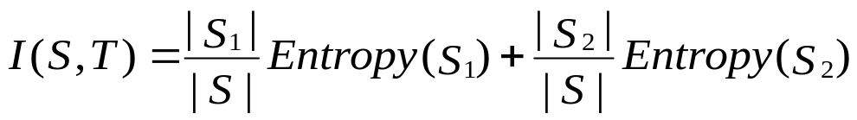
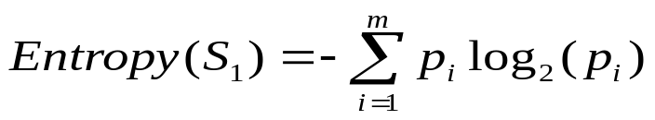
Entropy-Based Discretization
Given a set of samples S, if S is partitioned into two intervals S₁ and S₂ using boundary T, the information gain after partitioning is
Entropy is calculated based on class distribution of the samples in the set. Given m classes, the entropy of S₁ is
  where p_{i} is the probability of class i in S₁
The boundary that minimizes the entropy function over all possible boundaries is selected as a binary discretization
The process is recursively applied to partitions obtained until some stopping criterion is met
Such a boundary may reduce data size and improve classification accuracy

Slide 92
Interval Merge by χ² Analysis
Merging-based (bottom-up) vs. splitting-based methods
Merge: Find the best neighboring intervals and merge them to form larger intervals recursively
ChiMerge
  Initially, each distinct value of a numerical attr. A is considered to be one interval
  χ² tests are performed for every pair of adjacent intervals
  Adjacent intervals with the least χ² values are merged together, since low χ² values for a pair indicate similar class distributions
  This merge process proceeds recursively until a predefined stopping criterion is met (such as significance level, max-interval, max inconsistency, etc.)

Slide 93
Segmentation by Natural Partitioning
A simply 3-4-5 rule can be used to segment numeric data into relatively uniform, “natural” intervals.
  If an interval covers 3, 6, 7 or 9 distinct values at the most significant digit, partition the range into 3 equi-width intervals
  If it covers 2, 4, or 8 distinct values at the most significant digit, partition the range into 4 intervals
  If it covers 1, 5, or 10 distinct values at the most significant digit, partition the range into 5 intervals

Slide 94
Concept Hierarchy Generation for Categorical Data
Specification of a partial/total ordering of attributes explicitly at the schema level by users or experts
  street < city < state < country
Specification of a hierarchy for a set of values by explicit data grouping
  {Urbana, Champaign, Chicago} < Illinois
Specification of only a partial set of attributes
  E.g., only street < city, not others
Automatic generation of hierarchies (or attribute levels) by the analysis of the number of distinct values
  E.g., for a set of attributes: {street, city, state, country}

Slide 95
Automatic Concept Hierarchy Generation
Some hierarchies can be automatically generated based on the analysis of the number of distinct values per attribute in the data set
  The attribute with the most distinct values is placed at the lowest level of the hierarchy
  Exceptions, e.g., weekday, month, quarter, year
country
15 distinct values
province_or_ state
365 distinct values
city
3567 distinct values
street
674,339 distinct values

